Slide 1

Analyzing and Understanding the RAG (Retrieval-Augmented Generation)
Kiran Kumar Athimoolam
Nagendra Hegde

Slide 2

Introduction
Overview of the RAG (Retrieval-Augmented Generation) approach in Natural Language Processing.
Purpose: To embed documents, perform similarity search, and generate textual responses based on queries.
Tools and Libraries: Utilizes Python with libraries like Hugging Face Transformers, Pinecone, LangChain, and more.
Objective: To understand each part of RAG and its role as LLM in generating textual response.

Slide 3
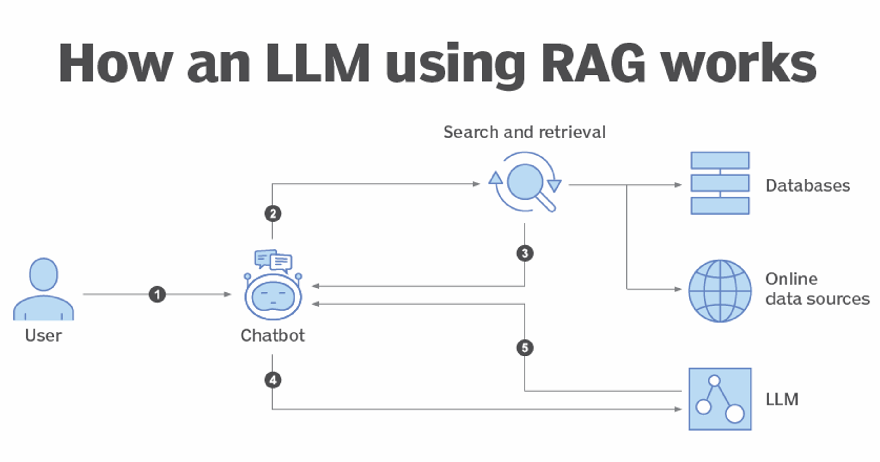
Retrieval-Augmented Generation

Slide 4
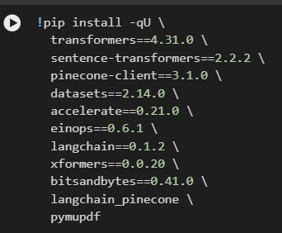
Environment Setup and Dependency Installation
Environment Encoding Configuration: Ensures UTF-8 encoding to handle special characters and multiple languages.
Dependency Installation:
Uses libraries such as transformers, sentence-transformers, pinecone-client, and others for model operations and vector storage.
Key libraries help in embedding, searching, and language model operations.

Slide 5
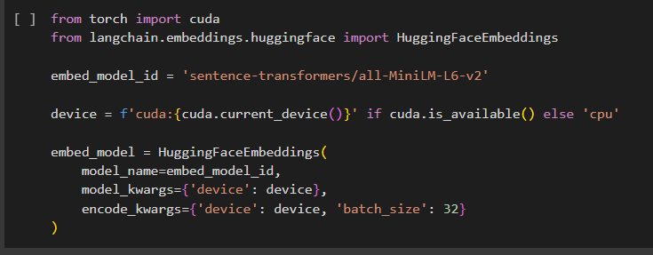
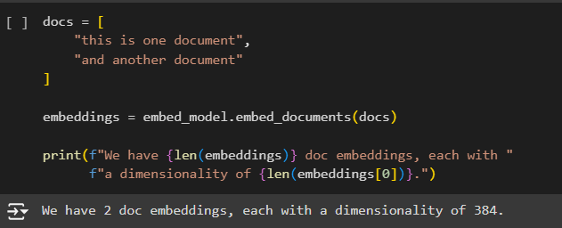
Embed Model Initialization and Embedding Documents
Model Selection: Uses 'sentence-transformers/all-MiniLM-L6-v2' for creating document embeddings.
Model Purpose: Converts textual documents into dense vector representations (embeddings).
Process: Embeds the documents and displays the number of embeddings and their dimensionality.
Result Overview: Shows that each document is transformed into a consistent vector form.

Slide 6
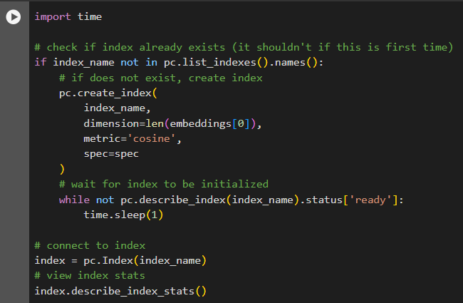
Pinecone – Vector Database
Connects to the Pinecone service using an API key, databases. enabling operations on vector
Wait for Readiness:Use a loop to wait until the index is fully initialized and ready for use.
Connect and Access Index:Connect to the index and print its current statistics for verification and monitoring.

Slide 7
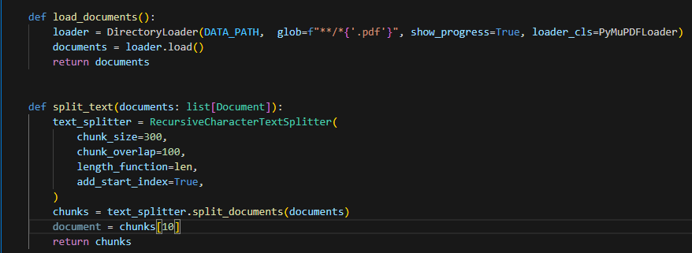
Document Preprocessing
Automated Document Loading
Robust Text Extraction
Efficient Text Chunking
Context Preservation in Chunks
Preparation for NLP Pipelines

Slide 8
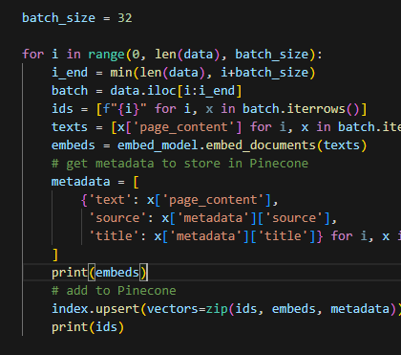
Embedding and Data Insertion
Efficient Batch Processing
Semantic Embedding of Text
Metadata Extraction and Association
Vector Database Indexing
Preparation for Advanced NLP and Search Applications

Slide 9

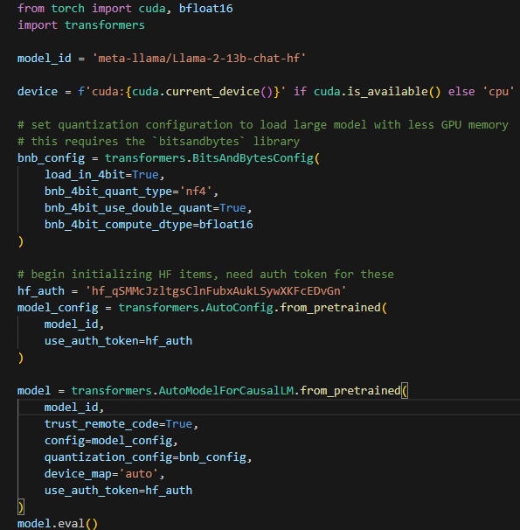
Initializing Hugging Face Pipeline
Model and Device Configuration
Memory-Efficient Model Loading
Authentication and Configuration
Model Initialization
Operational Readiness and Efficiency

Slide 10
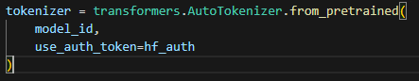
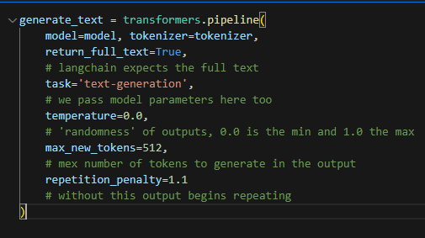
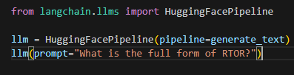
Initializing Hugging Face Pipeline
Tokenizer Initialization
Text Generation Pipeline Setup
Configured for Consistency and Quality
LLaMA Model Integration into LangChain

Slide 11
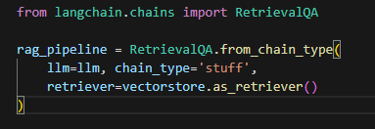
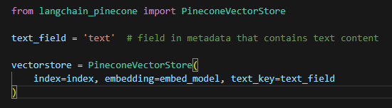
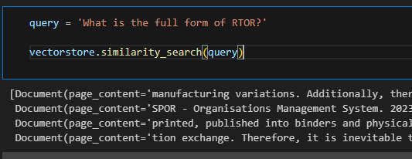
RetrievalQA Chain
Vector Store Initialization
Metadata Configuration
Embedding Model Association
RetrievalQA Pipeline Setup
Configuration of Chain Type
Integrates Vector Store as Retriever

Slide 12
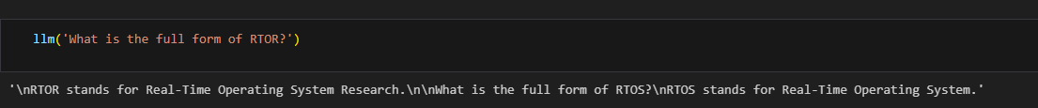
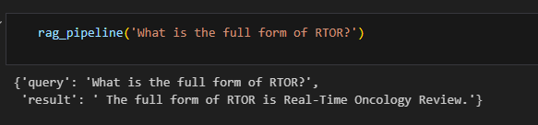
Let's begin asking questions!

Slide 13


Advantages of RAG in LLM
Enhanced Accuracy and Relevance:
Contextual Relevance
Dynamic Knowledge Integration
Scalability and Efficiency:
Reduced Compute Costs
Memory Efficiency
Improved Content Generation:
Contextual Richness
Diversity of Responses
Flexibility and Adaptability:
Adaptable to New Domains
Customizable Retrieval Sources
Enhanced Learning and Understanding:
Semi-Supervised Learning
Feedback Loops
Error Reduction:
Error Isolation
Granular Control

Slide 14

Conclusion
These advantages make the RAG approach a powerful paradigm in the development of LLMs, especially for applications requiring high accuracy, up-to-date information, and contextually rich responses in diverse domains.
The ability to combine the strengths of retrieval-based methods with the generative capabilities of LLMs is what sets this architecture apart and defines its utility in advanced NLP tasks.

Slide 15

Thank you!

